Slide 1
Predicting and Classifying Hurricane Characteristics
Ogechikanma Anosike, Sanjitha Bhaskar, Aidan Murphy, Maris Ryan

Slide 2
Overview
What we will cover
Algorithm Purpose
Algorithms
Implementation
Demonstration
Experimental Plan
Results
Limitations & Future Work
Concluding Remarks

Slide 3
Algorithm Purpose
Purpose: to solve the problem of predicting storm characteristics and classifying storm categories using machine learning algorithms based on historical hurricane data by analyzing the NOAA Atlantic Hurricane Database.
1. Predicting Wind Speed (Linear Regression)
Objective: Estimate the maximum sustained wind speed of a storm based on its attributes.
Inputs:
Date and time of report (year, month, day, hour), Storm location (latitude, longitude), Atmospheric pressure at the storm center, Wind force diameters (tropical storm and hurricane), Storm status (numerical encoding)
Output: Predicted wind speed (a continuous value).
2. Classifying Storm Category (Logistic Regression & Random Forest & LSTM)
Objective: Predict the Saffir-Simpson hurricane category (1–5 or NA) based on storm features.
Inputs:
Date and time of report (year, month, day, hour), Storm location (latitude, longitude), Atmospheric pressure at the storm center, Wind force diameters (tropical storm and hurricane), Wind speed
Output: Predicted storm category (a discrete class label)

Slide 4
Algorithm Purpose
Algorithms: Linear Regression, Logistic Regression, Random Forest Classifier
Tools:
Programming Language: Python
Libraries:
Scikit-learn: For implementing and evaluating machine learning models.
Matplotlib & Seaborn: For visualizing model predictions and residuals.
Pandas & NumPy: For data manipulation and preprocessing.

Slide 5
Algorithms
Linear Regression
Linear Regression
Logistic Regression
Logistic Regression
The algorithm uses Linear Regression to predict wind speed based on historical hurricane data from the NOAA Atlantic Hurricane Database.
The process begins by preparing the dataset, which involves cleaning missing values, encoding categorical data into numerical form, and selecting relevant features for prediction.
The selected features include attributes like storm status, geographic coordinates, time, and storm diameter measurements.
The model learns a linear relationship between these features (input variables) and wind speed (target variable) using the training data.Once trained, it predicts wind speeds on unseen test data.
The model's accuracy is assessed using performance metrics such as Mean Absolute Error (MAE), Mean Squared Error (MSE), R-squared (R²), and Cross-Validation Mean MSE. Visualizations, such as scatter plots and residual plots, are used to further evaluate the predictions and understand the model’s behavior.
The algorithm uses Logistic Regression to predict the category of a hurricane
The columns containing force diameter data contained a large amount of null values, these were replaced with the median of the respective columns to maximise available data
Categorical columns were converted into numerical form using encoding
Columns excluding category and name are used as features, category is the target variable
The data is split into training and test sets with 80% for training and 20% for testing
Accuracy and classification reports are calculated, along with a confusion matrix to evaluate model performance
The algorithm uses Linear Regression to predict wind speed based on historical hurricane data from the NOAA Atlantic Hurricane Database.
The process begins by preparing the dataset, which involves cleaning missing values, encoding categorical data into numerical form, and selecting relevant features for prediction.
The selected features include attributes like storm status, geographic coordinates, time, and storm diameter measurements.
The model learns a linear relationship between these features (input variables) and wind speed (target variable) using the training data.Once trained, it predicts wind speeds on unseen test data.
The model's accuracy is assessed using performance metrics such as Mean Absolute Error (MAE), Mean Squared Error (MSE), R-squared (R²), and Cross-Validation Mean MSE. Visualizations, such as scatter plots and residual plots, are used to further evaluate the predictions and understand the model’s behavior.

Slide 6
Algorithms
Linear Regression
Random Forest Classifier
Logistic Regression
LSTM
The algorithm uses Linear Regression to predict wind speed based on historical hurricane data from the NOAA Atlantic Hurricane Database.
The process begins by preparing the dataset, which involves cleaning missing values, encoding categorical data into numerical form, and selecting relevant features for prediction.
The selected features include attributes like storm status, geographic coordinates, time, and storm diameter measurements.
The model learns a linear relationship between these features (input variables) and wind speed (target variable) using the training data.Once trained, it predicts wind speeds on unseen test data.
The model's accuracy is assessed using performance metrics such as Mean Absolute Error (MAE), Mean Squared Error (MSE), R-squared (R²), and Cross-Validation Mean MSE. Visualizations, such as scatter plots and residual plots, are used to further evaluate the predictions and understand the model’s behavior.
The Random Forest Classifier predicts hurricane categories based on historical hurricane data from the NOAA Atlantic Hurricane Database.
The selected features are: 'year', 'month', 'day', 'hour', 'pressure', 'lat', 'long' ,'tropicalstorm_force_diameter', 'hurricane_force_diameter', 'wind'.
The Random Forest algorithm builds an ensemble of 100 decision trees. Each tree is trained on a random subset of the data and learns patterns to classify wind speed categories. The final prediction is made by aggregating the outputs of all trees, typically using majority voting.
The model is evaluated using metrics like accuracy, precision, recall, and F1-score. A confusion matrix and a heatmap are used to visually assess the model’s performance. This approach ensures robustness and interpretability, making it effective for complex, non-linear relationships in hurricane data.

Slide 7
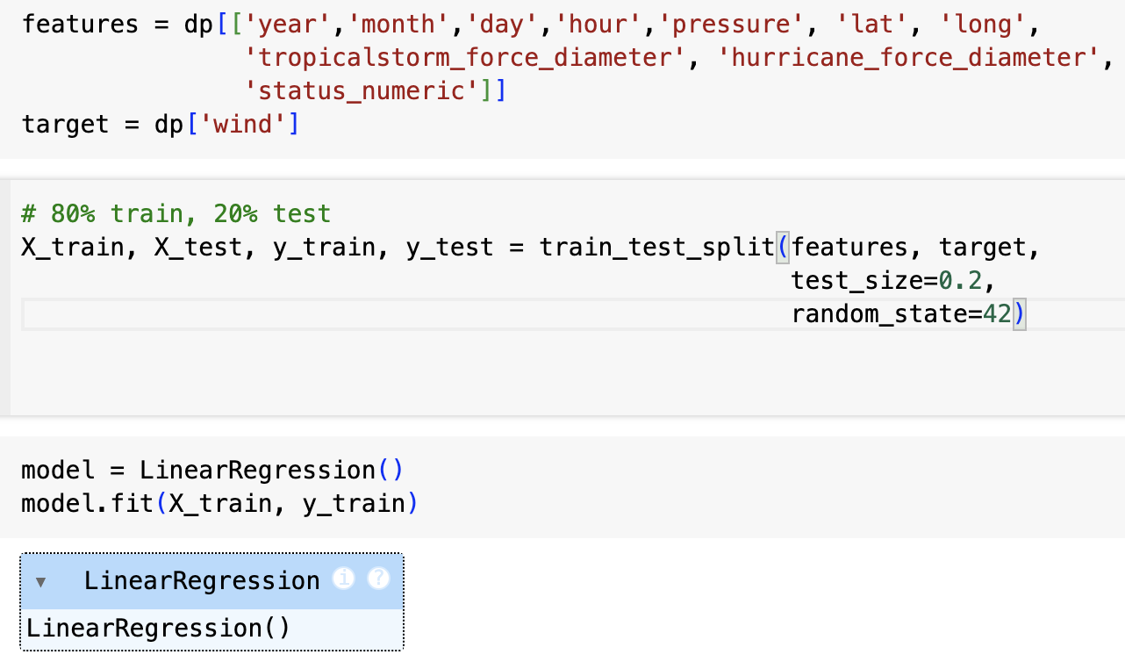
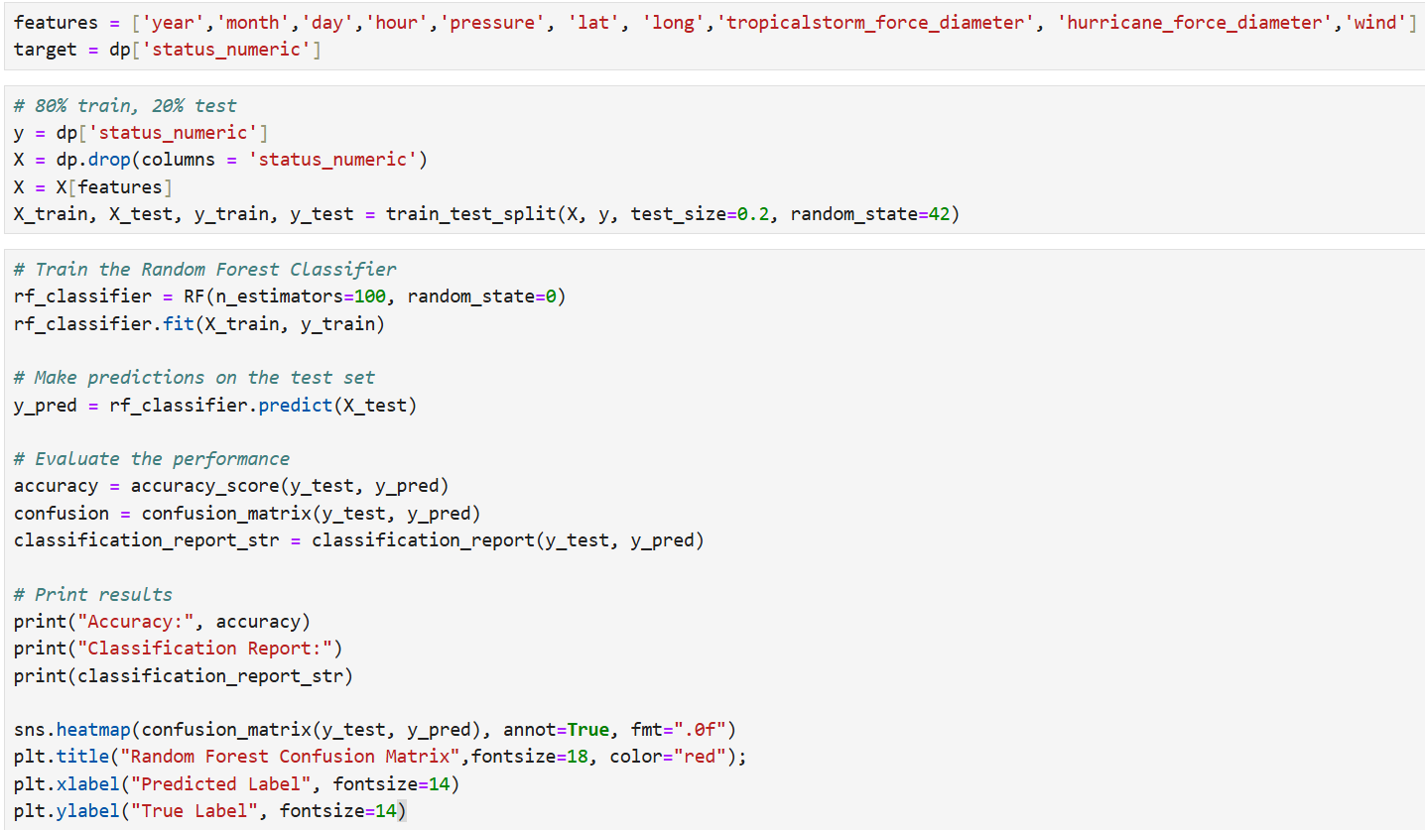
Implementation
Which language did we use?
Python

Slide 8
Demonstration

Slide 9
Experimental Plan
Information about our dataset
Description: The project uses the NOAA Atlantic Hurricane Database, which includes storm characteristics such as name, date, location, wind speed, pressure, category, and wind-force diameters. The dataset was downloaded from Kaggle.
Application:
Splitting: The dataset was split into training (80%) and testing (20%) subsets using train_test_split.
Implementation:
Linear regression – The model predicts wind speed based on selected features, trained on the training set and evaluated using MAE, MSE, and R-squared.
Logistic regression –
Random forest –

Slide 10
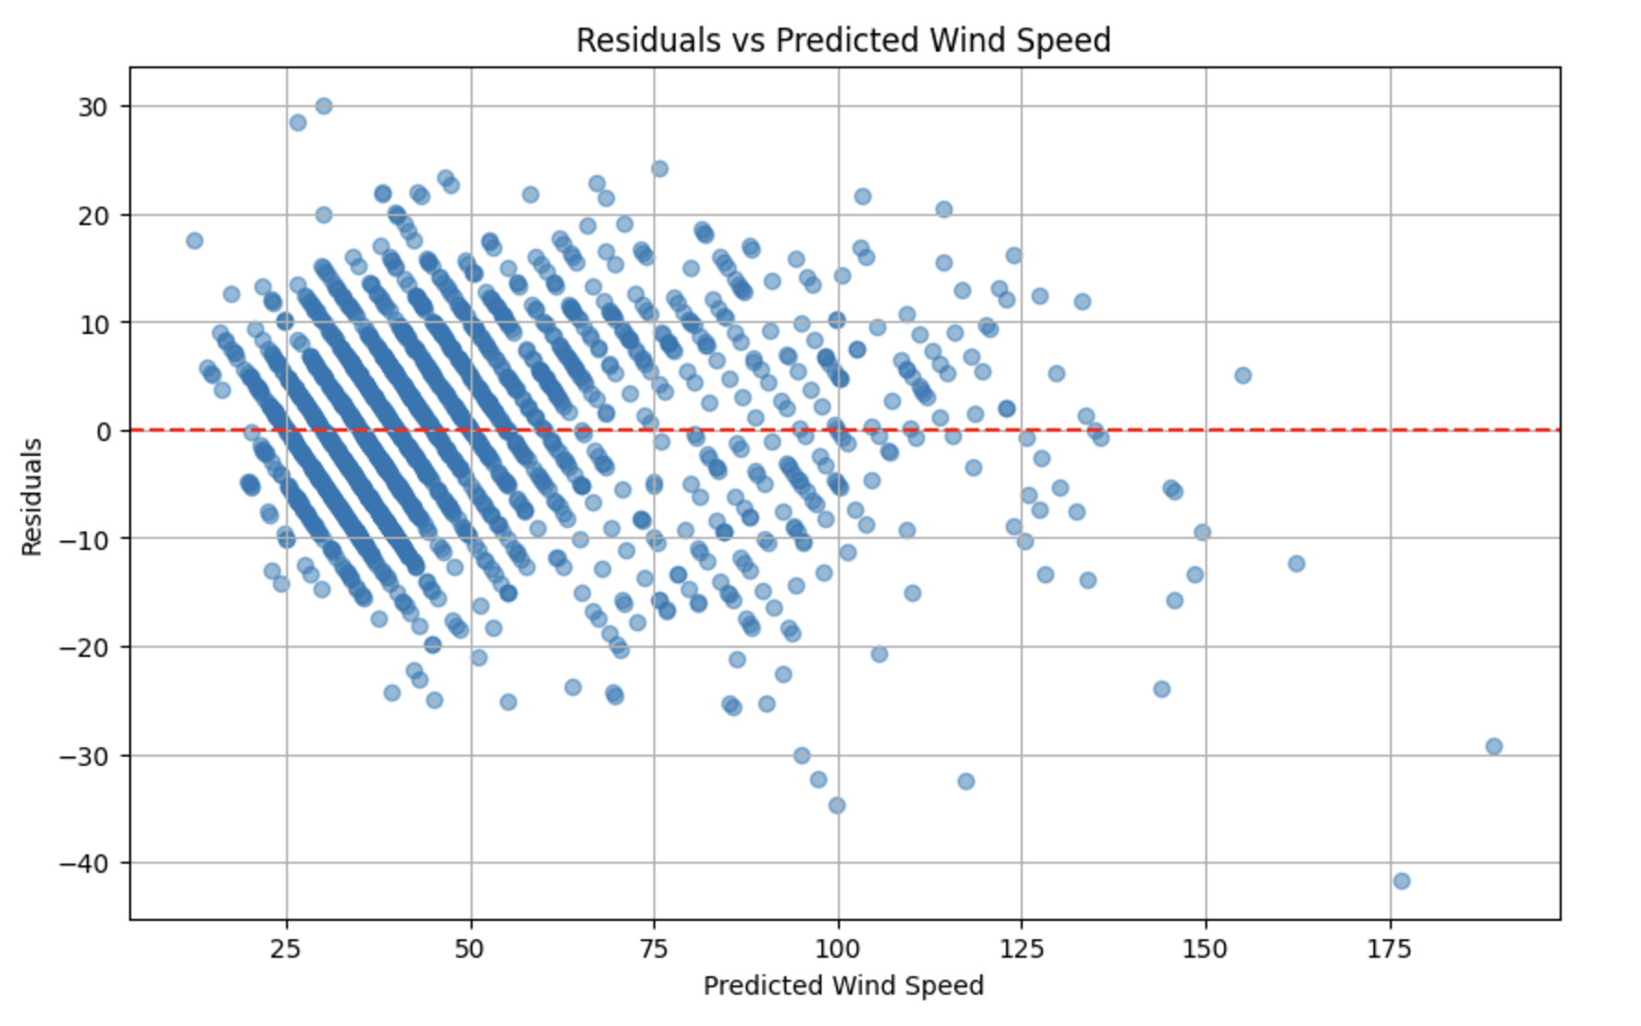
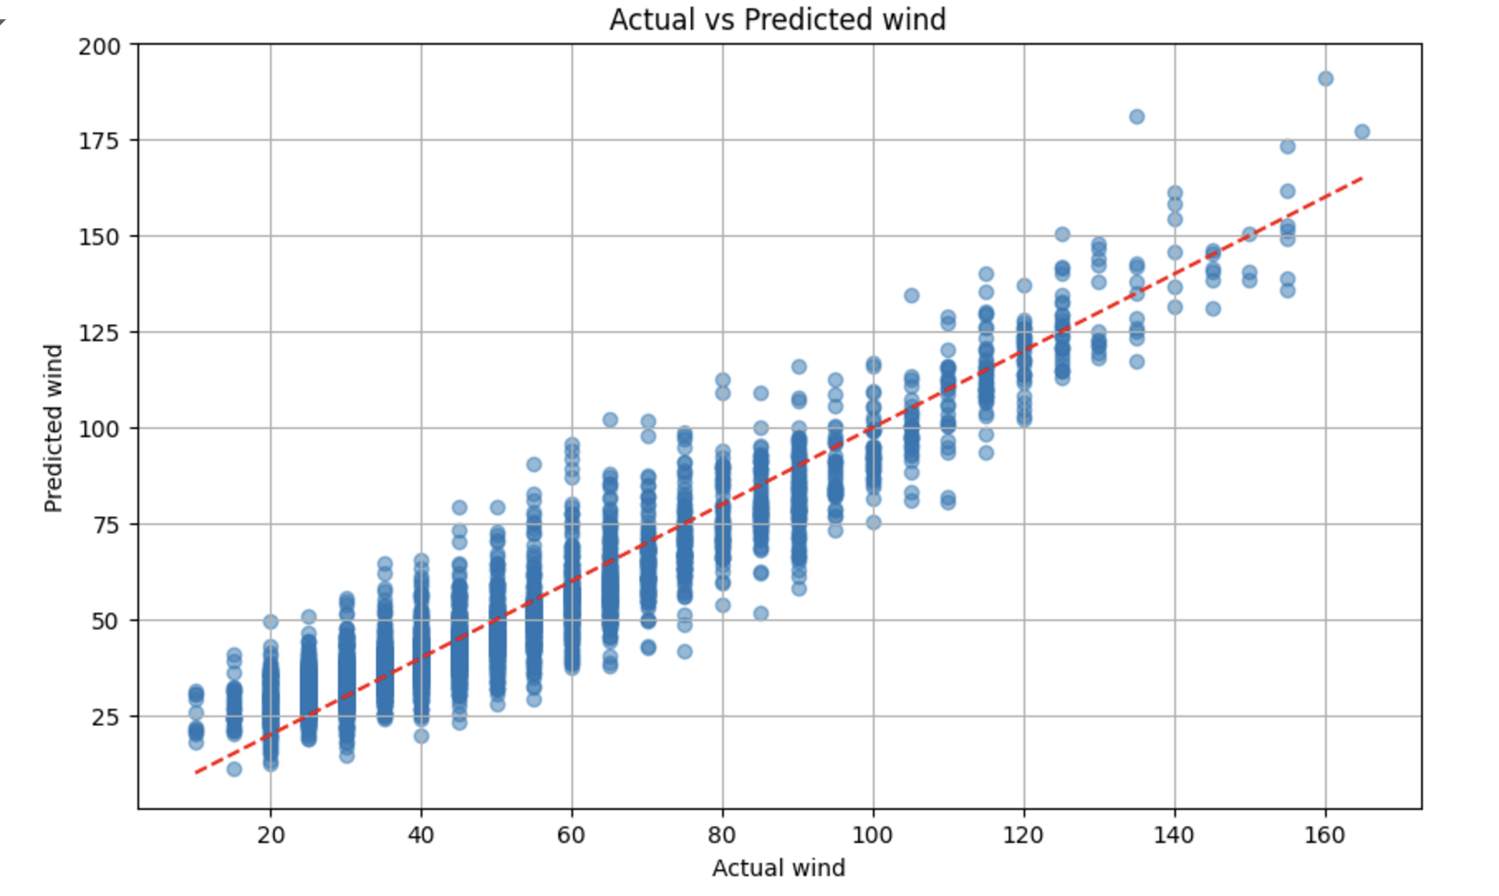
Linear Regression Results
MAE | MSE | R² | CV MSE
7.00 | 79.45 | 0.88 | 75.96
MAE: Average prediction error of 7 knots, a small error relative to the wind speed range of 155 knots, indicating good performance.
MSE: Confirms low overall prediction errors, even with amplified larger errors.
R-squared: 88% variance explained, showing a strong relationship between features and wind speeds.
Cross-Validation MSE: Supports model generalizability with consistent performance across data subsets.

Slide 11
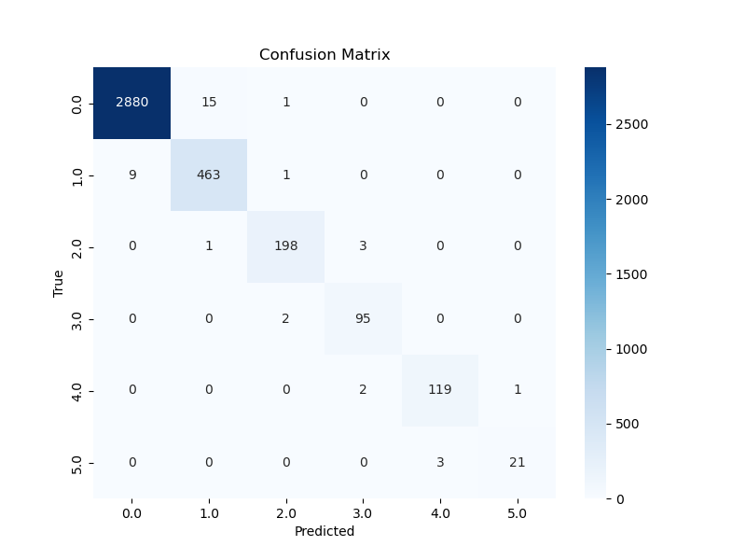
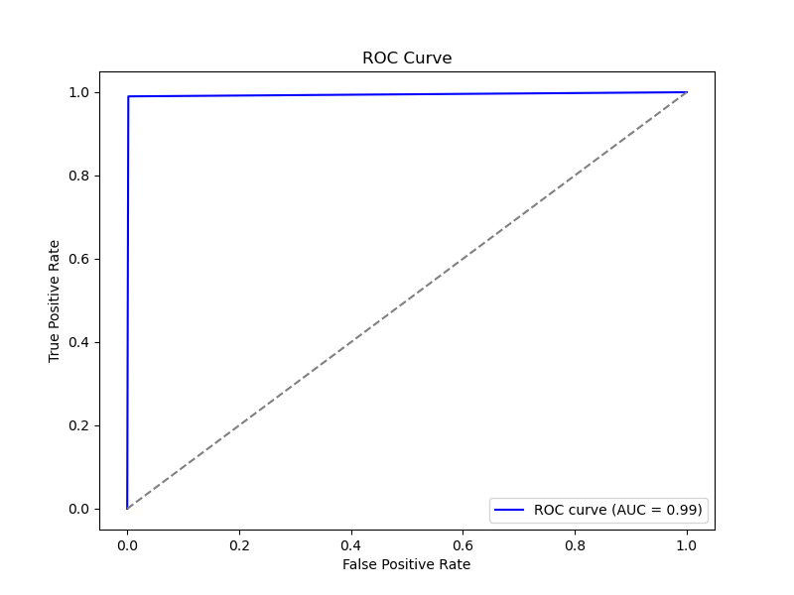
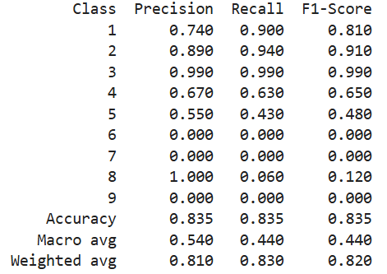
Logistic Regression Results
The ROC curve indicates a high level of true positives
The AUC is close to 1, confirming the model’s high performance

Slide 12
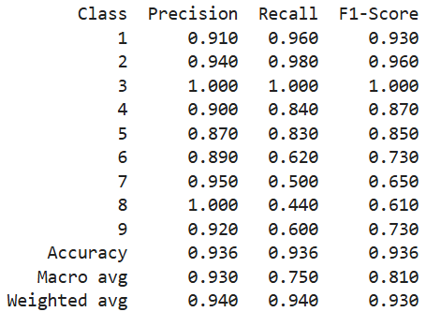
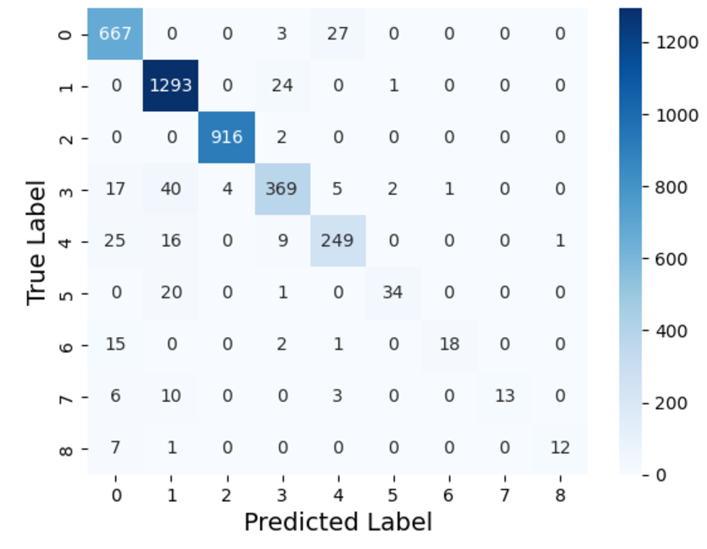
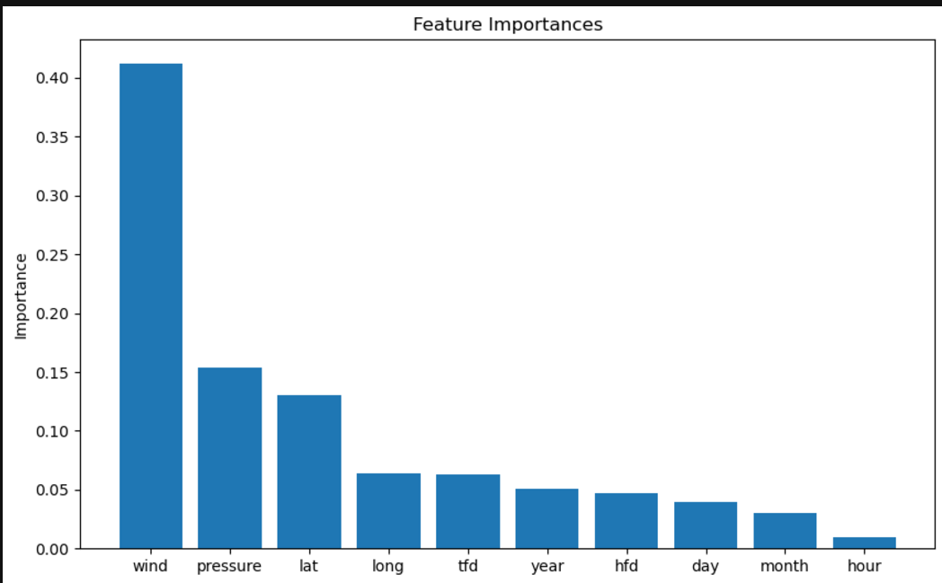
Random Forest Results
Overall accuracy is 93.60%, with the model predicting correctly for most samples.
Misclassification is more common in higher categories (e.g., class 6, 7, and 8) with smaller sample sizes.
Class 3 has almost perfect predictions (916 out of 918 correct).
High precision in classes like 3 indicates few false positives, while lower precision in class 8 shows selective predictions.
High recall for classes like 2 (0.98) means most samples are identified, while low recall for class 7 (0.50) shows difficulty detecting all samples.
Macro average reflects poor performance on minority classes, while the weighted average aligns more closely with overall accuracy.
Notes:
The overall accuracy is 93.60%, meaning that the model predicts the correct class for a significant majority of the samples.
Misclassification is more frequent in higher categories (e.g., class 6, 7, and 8), where sample sizes are smaller, and predictions are less accurate.
Class 3 has almost perfect predictions, with 916 out of 918 samples classified correctly.
High precision (e.g., class 3 with 1.00) means few false positives.
Lower precision (e.g., class 8 with 1.00 but lower recall) suggests the model predicts this class very selectively, likely missing others.
High recall (e.g., class 2 with 0.98) means most samples of that class are correctly identified.
Low recall (e.g., class 7 with 0.50) suggests the model struggles to detect all samples in that class.
High F1-scores for classes 1, 2, and 3 indicate the model performs very well.
Lower F1-scores for smaller classes (e.g., class 6, 7, and 8) indicate poorer performance due to either false positives or false negatives.
Macro average: Treats all classes equally, resulting in lower values due to poor performance on minority classes.
Weighted average: Accounts for class imbalance, favoring more populous classes and aligning closely with overall accuracy.
Imbalanced Data: Classes 6, 7, and 8 have significantly fewer samples, leading to poor recall and F1-scores. This is a common issue in imbalanced datasets.
Dominant Classes: The model performs exceptionally well for dominant classes like 2 and 3, likely due to sufficient training samples and stronger feature patterns.

Slide 13
LSTM Results

Slide 14
Limitations & Future Work
Limitations Future Work
Resampling Techniques: Use oversampling (e.g., SMOTE) or undersampling to balance class distribution.
Class Weights: Adjust the loss function to penalize misclassifications of minority classes more heavily.
Tuning Model Hyperparameters: Fine-tune hyperparameters to improve recall for lower-performing classes.
Feature Engineering: Add or refine features to help the model differentiate minority classes.
Model Evaluation with Different Metrics: Use F1-score, ROC AUC, and Precision-Recall curves for better assessment of imbalanced classes.
Cross-validation: Use cross-validation to avoid overfitting and get a more robust performance estimate.
Ensemble Methods: Apply ensemble methods like Random Forests, XGBoost, or LightGBM for better handling of imbalances.
Classes 6, 7, 8, and 9 have low recall and precision, suggesting under representation or difficulty in prediction.
The model may be biased toward majority classes, leading to poor performance on minority ones.
Low recall in classes 6, 7, 8, and 9 indicates the model struggles to identify instances from these classes.
Black-box models may lack explainability, making it difficult to understand poor predictions for certain classes.
A trade-off between precision and recall exists, with some classes (e.g., 7 and 8) showing high precision but low recall.

Slide 15
Concluding Remarks
This project demonstrates the application of machine learning to predict storm characteristics and classify hurricane categories based on historical data.
Key Outcomes:
Linear Regression accurately predicted wind speed with an R² of 88%.
Logistic Regression achieved 83.5% accuracy in classifying storm categories, effectively capturing patterns in categorical outcomes.
Random Forest delivered 93.6% accuracy, excelling in classifying dominant storm categories while highlighting challenges in rare class predictions.
LSTM successfully modeled temporal dependencies for predicting maximum wind speeds.
Impact:
These models provide actionable insights for early warning systems and disaster preparedness, enabling data-driven decisions in storm risk management.
Future Directions:
Addressing class imbalance and incorporating advanced feature engineering can further enhance model robustness, especially for rare storm events.

Slide 16
Questions?

